Slide 1
Higher National Diploma (HND)
Digital Technologies
Unit 20: Internet of Things
Week 6, Session 1:
IoT Application Development – Prototype Testing

Slide 2
RECAP FROM PREVIOUS SESSION
Last session, you:
Created a prototype of your smart bin
Learned how to make modifications to your smart bin
Can some list the IoT hardware they used to build their smart bin?

Slide 3
SESSION AIM AND OUTCOMES
By the end of this class, students will be able to:
Evaluate methods for testing an IoT solution
Design a complete test plan for an IoT application
Create and conduct end-user experiments
Analyse and sequence the steps required for experiments
Critically assess key steps in the IoT application development phase

Slide 4
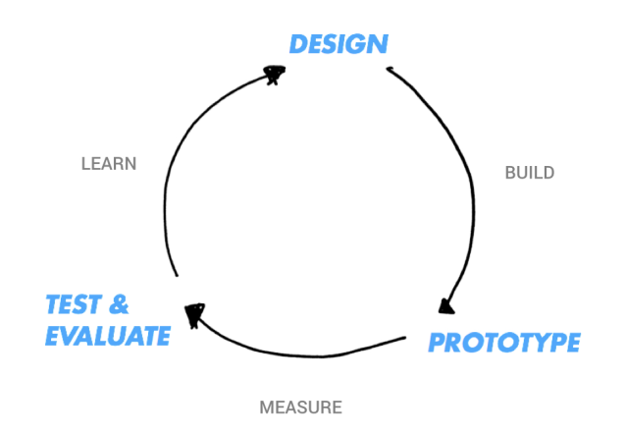
POST PROTOTYPING: TESTING THE PROTOTYPE
After prototyping (e.g., smart bin), a key step that is needed is to test the prototype.
Purpose:
Assess the prototype’s effectiveness
Identify areas for improvement
Refine and enhance the IoT design
(Raj and Raman, 2017)

Slide 5
KEY FOCUS AREAS FOR TESTING
Reliability: Ensuring the system consistently performs as expected
Security: Protecting data and devices from threats
Interoperability: Seamless integration with other systems or devices
Performance: Efficiency, speed, and responsiveness of the system
User Experience: Meeting user expectations and usability
(Raj and Raman, 2017)

Slide 6





CLASS ACTIVITY 1
Task:
Form a group of four
Think and discuss additional areas of testing
Report back to the class on your discussion

Slide 7
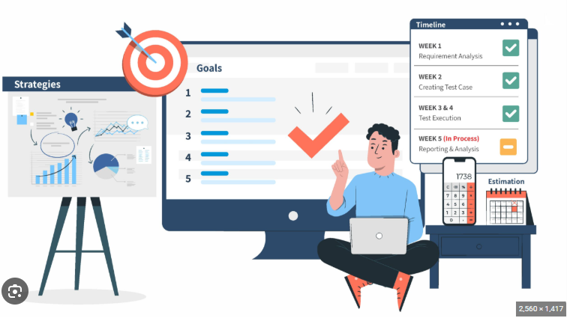
TEST PLAN AND WHY IS IT IMPORTANT
For every testing you will conduct, you will need a test plan
A test plan is a detailed document that outlines the strategy, scope, resources, schedule, and approach for testing a system
Purpose:
It ensures that testing is organised, systematic and effective
Helps to define what and how to test
Helps to identify issues early and improving system reliability
(Nindel-Edwards, 2007).

Slide 8
STRUCTURE OF A TEST CASE
Component | Description
Test ID | Unique identifier for the test case (e.gTC001)
Description | Short explanation of what the test is verifying
Test step/Input | Step by step instructions to perform the test and any input data
Expected results | What should happen if the system is working correctly
Pass or fail criteria | How to determine whether the test was passes or fails
(Afzal, 2007; Elghondakly, 2016).

Slide 9
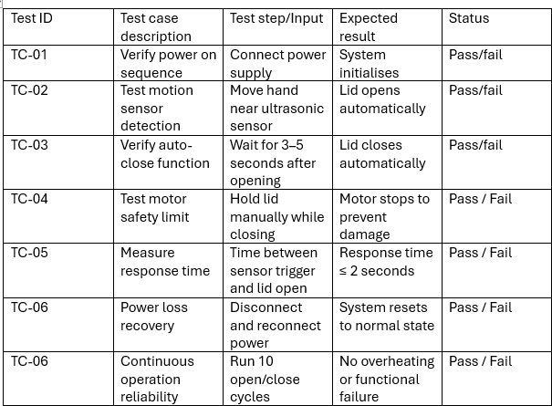
EXAMPLE OF A DETAILED BLACK BOX TEST PLAN FOR THE SMART BIN

Slide 10
COMPONENTS OF A TEST PLAN
Scope: What will be tested and what will not
Objectives: Goals of testing
Test Criteria: Pass/fail conditions, success metrics
Resources: Personnel, hardware, software, and tools required
Schedule and Timeline: When tests will be conducted
Testing Approach/Methodology: Black box, white box, end-user experiments
Risk Assessment: Potential risks and mitigation strategies
Reporting: How results will be documented and communicated
(Afzal, 2007; Calp and Kose, 2019).

Slide 11

CLASS ACTIVITY 2
Question:
What is your experience with any of the testing approaches/methodologies?
I have run a Black Box test
I have run a White Box test
I was a participant in an IoT experiment
I have observed automated/manual testing
I have not been exposed to any IoT prototype testing
Now let us have a look at two of these approaches

Slide 12
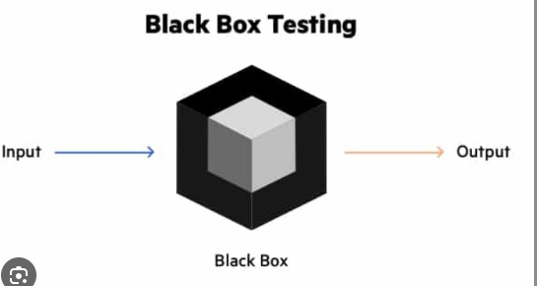
BLACK BOX TESTING IN IOT
Type: Functional testing
Purpose: Verify IoT functionality without looking at internal code
Approach: Tester ignores system’s internal structure
Importance: Ensures components work as expected in all environments
Key Point: Focuses on input-output behavior, not implementation
(Ashtari, 2022)

Slide 13
FEATURES OF BLACK BOX TESTING:
No knowledge of internal codes
Gives direct input from real users
Involves a system whose behavior must be observed entirely by inputs and outputs
Test cases can be used to target a specific feature or features
Liable to human error
(Testsigma Technologies Inc., n.d.)

Slide 14
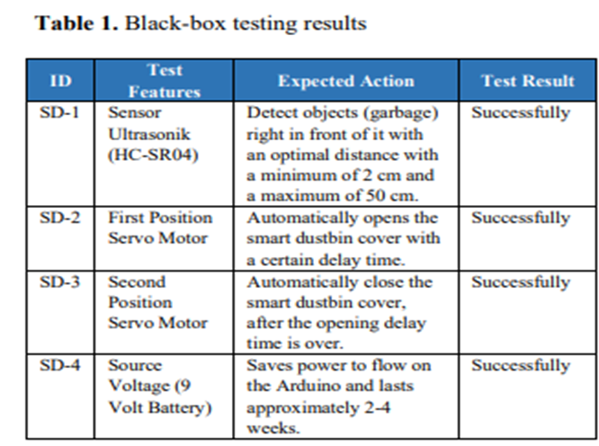
BLACKBOX TESTING FOR THE SMART BIN
You will need to assess the functionalities of the smart bin.
To do so, you may need to assess the following:
  Does the sensor detect people?
  Does the servo motor opens the bin at a certain delay time?
  Does the servo motor closes the bin after the opening delay time is over
To your right is a black box testing result conducted on a smart bin
(Asyikin and Subandi, 2020).

Slide 15
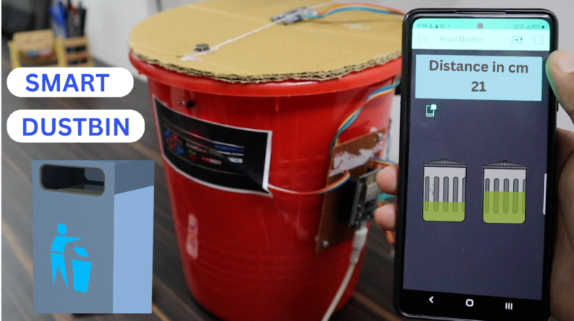
END USER EXPERIMENTS
Type: Experiment
Purpose: Test hypotheses to improve the IoT product
Approach: Observe and analyse how users interact with the product using a scientific method
Importance: Identifies ways to enhance usability and functionality based on real user behavior
Key Point: Focuses on understanding user interactions and refining the product accordingly
(Hotjar Ltd, 2022)

Slide 16
HOW EXPERIMENT FIT IN THE OVERALL PICTURE -THE WHY?
Provide helpful insight, which can drive the IoT application forward
Help an IoT developer along the path to reaching goals
Help in optimising and improving the product
Validates and uncovers the required parameters prior to the final deployment
Get direct input from people who will be using the IoT solution
Decrease costly errors
(Holmes, n.d).

Slide 17
RUNNING USER EXPERIMENT– THE HOW?
Steps to run an IoT user experiment:
Create the test plan.
Run the experiment based on the plan
Get stakeholders' input
Analyse the Results
Iterate and Improve
Repeat
Afzal, 2007; Holmes, R., n.d; Hotjar Ltd, 2022; Maze, n.d; . Philips, M., 2016)
Notes:
For instance, you might want to evaluate the smart dustbin application's usability or its efficacy.

Slide 18
CLASS ACTIVITY 3
Task:
Form a group of four to create a test plan for a smart bin
Select one individual to conduct a black box testing or user experiment
Other group members act as end users during the experiment
Follow the test plan to evaluate the smart bin

Slide 19
SUMMARY
In this lesson we have look at:
Testing as a critical step involved in IoT application development
Understand the benefits of conducting testing in IoT application development
Identify the features of a black box testing
Identify the steps needed to run end-user experiments
We conclude that when developing an IoT application, testing is essential.

Slide 20
REFERENCES
Afzal, W. (2007). Metrics in Software Test Planning and Test Design Processes. Retrieved from https://www.diva-portal.org/smash/get/diva2%3A833623/FULLTEXT01.pdf
Ashtari, H., 2022. Black Box vs. White Box Testing: Understanding 3 Key Differences [Online] Available at: https://www.spiceworks.com/tech/devops/articles/black-box-vs-white-box-testing/ [Accessed 24 June 2023].
Calp, M. H., & Kose, U. (2019). Planning activities in software testing process: A literature review and suggestions for future research. arXiv preprint arXiv:1903.01222.
Elghondakly, R. (2016). A comprehensive study for software testing and quality assurance. ACM Computing Surveys (CSUR), 49(1), 1-35. https://doi.org/10.1145/2896387.2896435
Hamilton, T., 2023. What is BLACK Box Testing? Techniques, Types & Example [Online] Available at https://www.departmentofproduct.com/blog/design-experiments-product/ [Accessed 24 June 2023].
Heusser, M., 2021. [Online] Available at: https://www.imperva.com/learn/application-security/black-box-testing/ [Accessed 24 June 2023].
Holmes, R., n.d. How to Design Experiments for Your Product [Online] Available at https://www.departmentofproduct.com/blog/design-experiments-product/ [Accessed 24 June 2023].
Hotjar Ltd, 2022. Product experimentation: what is it and why does it matter? [Online] Available at: https://www.hotjar.com/product-experimentation/ [Accessed 24 June 2023].
27

Slide 21
REFERENCES Continued
Imperva, 2023. Black Box Testing [Online] Available at: https://www.imperva.com/learn/application-security/black-box-testing/ [Accessed 24 June 2023].
Littlefish, 2021. Black Box Testing | Complete Uk Guide [Online] Available at: https://www.littlefish.co.uk/insights/black-box-testing-complete-uk-guide/ [Accessed 24 June 2023].
Maze, n.d. Product experimentation: How to conduct and learn from experiments [Online] Available at: https://maze.co/guides/product-research/product-experimentation/#:~:text=Product%20experimentation%20is%20the%20process,color%20changes%20to%20new%20features. [Accessed 24 June 2023].
Philips, M., 2016. Evolving UX: Experimental Product Design with a CXO [Online] Available at: https://www.toptal.com/designers/ux/experimental-product-design [Accessed 24 June 2023].
Singh, R., 2023. A guide to IoT software testing: Its approach and importance [Online] Available at: https://www.headspin.io/blog/iot-software-testing-guide [Accessed 24 June 2023].
Testbirds, 2022. Black Box Testing – Enhancing User Experience [Online] Available at: https://www.testbirds.com/en/blog/black-box-testing-enhancing-user-experience/ [Accessed 24 June 2023].
Testsigma Technologies Inc., n.d. Black Box Testing | What it is, Types , Techniques & Examples [Online] Available at: https://testsigma.com/guides/black-box-testing/ [Accessed 24 June 2023].
27

Slide 22

QUESTION

Slide 23
Higher National Diploma (HND)
Digital Technologies
Unit 20: Internet of Things
Week 6, Session 2: User Feedback Session

Slide 24

RECAP FROM PREVIOUS SESSION
Last Session:
Focused on testing IoT solutions
Discussed and designed test plans for IoT applications
Reviewed black box testing and end-user experiments
Analysed and sequenced steps for conducting experiments
Can someone remind us of the steps to run an IoT user experiment

Slide 25
SESSION AIM AND OUTCOMES
By the end of this class, students will be able to:​
Evaluate the concept and importance of user feedback in IoT applications
Critically assess key steps in planning an effective IoT user feedback session
Design and conduct user feedback session​
Analyse, reconcile, and interpret feedback to inform design improvements

Slide 26

USER FEEDBACK SESSION
Task-based method for evaluation of products at an early stage of development
Conducted during or after testing
Collects opinions and experiences from real users
Applicable across all testing approaches
Can involve a small sample of the target user group
Performance data is typically not gathered for this kind of evaluation
(UXPin, 2023; Singh, and Bezuayehu,2013).

Slide 27
USER FEEDBACK SESSION- THE WHY?
Informed Decisions: Use real user input to guide design choices
Enhanced Usability: Improve ease of use and accessibility
Elevated Customer Experience: Ensure satisfaction and engagement
Promotion of Inclusive Design: Address diverse user needs
Guide and Refine: Improve the design process
Ensure Alignment: Match solution with user requirements
Evaluate Effectiveness: Assess performance and value
Validate Design: Confirm the solution is fit for purpose
(UXPin, 2023)

Slide 28





CLASS ACTIVITY
TASK
Form a group of four to discuss the purpose of user feedback evaluation in the smart bin testing.

Slide 29

PLANNING USER FEEDBACK SESSION- THE HOW
Subsequent slides will discuss the steps you need to take in planning an IoT user feedback session.

Slide 30

STEP 1 DETERMINE DESIGN FOCUS
Define the purpose of your feedback session
Develop guiding questions and ideas for user input
Identify scenarios or tasks to validate
Prepare the prototype you will present to users
Select key functionalities or features to explore
(Singh, and Bezuayehu,2013).

Slide 31

STEP 2 DEVELOP YOUR INTERVIEW/TEST GUIDE
Create a structured guide to shape conversations with participants
Ensure the guide is clear, simple, and easy to follow
Include a background or context for the experiment/test
List main and probing questions to explore user experiences
Organize questions in a logical sequence
Outline the test protocol, scenarios, and task list
(Singh, and Bezuayehu,2013).

Slide 32
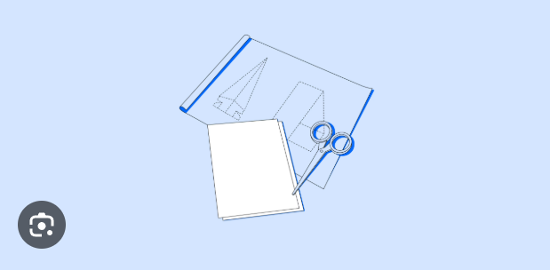
STEP 3: CREATE A PROTOTYPE NAVIGATION AND INTERACTION GUIDE
Prepare a document to guide interaction with the prototype
Helps the coordinator stay focused during testing
Specify the prototype’s state at the time of testing
Outline user actions or tasks to complete during the experiment
Use for review: Assess how well the prototype meets user needs
(Singh, and Bezuayehu,2013).

Slide 33

STEP 4 REVIEW THE DOCUMENT
Ask your Project Team if they want to add any task-based or overall questions
Finalise the document
(Singh, and Bezuayehu,2013).

Slide 34

STEP 5 CONDUCT A PILOT TEST/EXPERIMENT WITH USERS
Verify that all technical elements function correctly
Gain insights into the type of responses participants may give
Refine and finalise the original experiment based on findings
Recommended step: Helps minimise unforeseen issues and ensures smoother main testing
(Singh, and Bezuayehu,2013).

Slide 35
WHAT YOU NEED TO CARRY OUT A USER FEEDBACK SESSION
Prototype: A functional version of the product to test
End Users: Participants who will provide feedback
Task Script: Well-designed tasks and scenarios for users to complete
Coordinator: Facilitator to guide users and ask questions
Recording Method: Notes, audio, or video tools to capture feedback
Testing Location: A suitable environment for conducting the session
(Singh, and Bezuayehu, 2013).

Slide 36
CLASS ACTIVITY 1
TASK
Please engage with the following interactive activity:
Copy and paste the link below into your web browser
https://create.kahoot.it/share/what-you-do-not-need-to-carry-out-a-user-feedback-session/97575163-623d-4559-b932-5792bb31c675
Complete the Kahoot quiz titled “What You Do Not Need to Carry Out a User Feedback Session.”
Reflect on your answers and be prepared to discuss what you learned with the class.

Slide 37

RECONCILING AND EVALUATING END USER FEEDBACK
After conducting your user feedback session, it is essential to review and evaluate the feedback received
This process helps you gain meaningful insights into your design and product performance
Feedback evaluation supports identifying strengths, weaknesses, and opportunities for improvement
The next slides will outline the steps to reconcile and evaluate user feedback gathered during your formative activity
(Marche, 2021).

Slide 38
RECONCILING AND EVALUATING END USER FEEDBACK- THE HOW
1. Identify Common Feedback:
List the frequent comments made by end users.
2 Sort Feedback:
Sort the comments into positive and negative categories.
3. Analyse Comments:
Examine the comments to find any patterns or trends.
4. Establish Benefits and Drawbacks:
Based on the input collected, establish the benefits and drawbacks of the selected IoT techniques.
5. Make Improvements:
Adjust the IoT application to address the issues found based on the comments obtained.
(Mangiapanello, 2015)

Slide 39
CLASS ACTIVITY 2
Task:
Form a group of four students
Ask a group member to lead a feedback session for his/her smart bin
Use the other group members as end users
As a group, review and evaluate the feedback received
Prepare to report your evaluation of this input to the class

Slide 40
Week 6 – Discussion Forum
PLEASE ENGAGE WITH THE DISCUSSION FORUM BEFORE NEXT CLASS.

Slide 41
Week 6 – Generative AI playground
GO TO MOODLE AND ENGAGE WITH THE GENERATIVE AI PLAYGROUND

Slide 42
SUMMARY
In this lesson we have look at:
A critical step involved in IoT application development- user feedback session
Understand the benefits of collecting feedback in IoT application development
Identify the steps needed to examine feedback from users.
Recognise the steps needed to reconcile and evaluate end user feedback
We conclude that when developing an IoT application collecting and examining relevant feedback are essential.

Slide 43
REFERENCES
AI and the LinkedIn community, 2023. How do you use user feedback in your IoT design? [Online] Available at: https://www.linkedin.com/advice/0/how-do-you-use-user-feedback-your-iot [Accessed 24 June 2023].
Mangiapanello, K. A. (2015). An Analysis of Feedback from a Behavior Analytic Perspective. Journal of Applied Behavior Analysis, 48(4), 1001–1017. https://doi.org/10.1002/jaba.239
Marche, C. (2021). Analysis of Feedback Evaluation for Trust Management in IoT. MDPI Sensors, 2(3), 25. Retrieved from https://www.mdpi.com/2624-831X/2/3/25
Singh, T. and Bezuayehu, L.,2013. How to Run an End User Feedback Session on Your Product [Online] Available at: https://static1.squarespace.com/static/59b597dcf9a61eed0ea981f1/t/59ba79c6cf81e01807626ed9/1505393171818/FINAL_How+to_Run_an_End_User_Feedback_Session_on_your_product_TGS_LULIT_MK.pdf [Accessed 24 June 2023].
UXPin, 2023. What is User Feedback? [Online] Available at: https://www.uxpin.com/studio/blog/user-feedback/ [Accessed 24 June 2023].

Slide 44
QUESTION

